Slide 1
Why climate models BUG biologists
Nick Smith
BUGS
March 30, 2019

Slide 2
The world is projected to war 4°C by 2100
IPCC (2013)

Slide 3
Says who?
IPCC (2013)

Slide 4
Earth System Models
Dr. Kaitlin Naughten

Slide 5
Why do Biologists care?

Slide 6
Why do Biologists care?
There is a lot of Biology in ESMs

Slide 7
Dr. Kaitlin Naughten

Slide 8
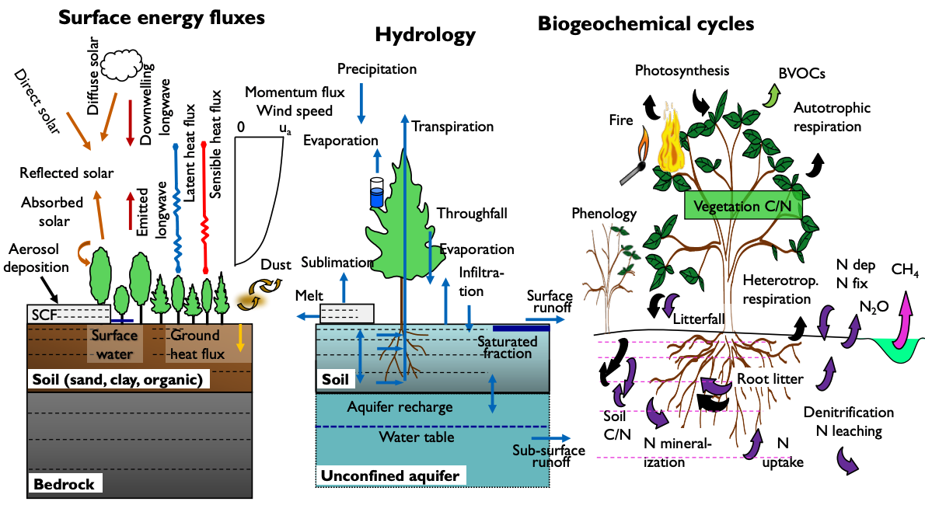
Dave Lawrence (NCAR)

Slide 9
Why do Biologists care?
There is a lot of Biology in ESMs
And that Biology matters!

Slide 10
Soil microbial
respiration
60 PgC/yr
Photosynthesis
120 PgC/yr
Fossil fuel burning
<10 PgC/yr
IPCC (2013)

Slide 11
Why do Biologists care?
There is a lot of Biology in ESMs
And that Biology matters!
There is a lot of Biology missing from ESMs

Slide 12
Why do Biologists care?
There is a lot of Biology in ESMs
And that Biology matters!
There is a lot of Biology missing from ESMs
…which may or may not matter

Slide 13
I’m convinced, what do I need to know to get my Biology in an ESM?

Slide 14
Why climate models BUG biologists
Nick Smith
BUGS, March 30, 2019

